Slide 1
Newchurch Village Community Association

Slide 2
There are four areas we wish to register in Newchurch:-
1).The Bowling Green at The Boars Head
2). The Car Park at the Boars Head
3). The Little Park
4). The Car Park adjacent to the North side of St. Nicholas' Church.

Slide 3
1). The Car Park at The Boars Head, Newchurch.

Slide 4
LCC Map of Site

Slide 5
Aerial View of Site

Slide 6
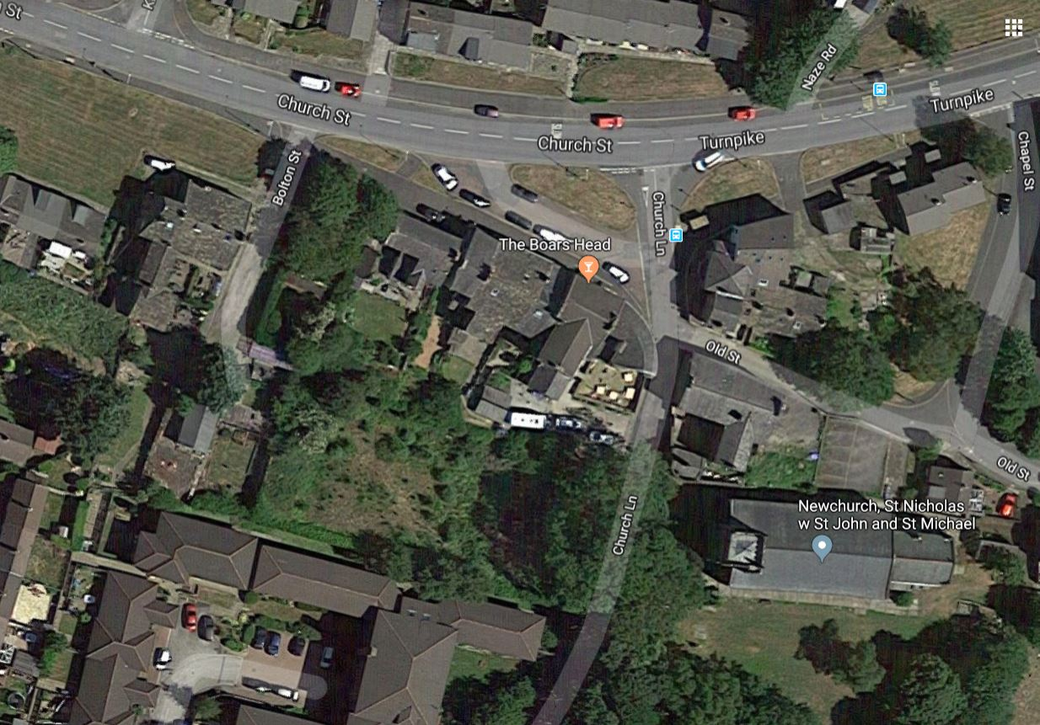
Aerial View of Site – 2

Slide 7
The Car Park to the rear of the Boars Head was utilised not only by customers of the pub, but by the teams of bowlers who came to play on the Bowling Green, and on other occasions, by worshippers of St. Nicholas' Church – with permission of the landlord at the time.
Circa 1992, the beer garden and the land surrounding the car park, were the regional winners of a competition organised by the brewery at the time – “Bass in Bloom”.

Slide 8
Regional Winner “Bass in Bloom” c.1992

Slide 9
Regional Winner “Bass in Bloom” c.1992

Slide 10
Regional Winner “Bass in Bloom” c.1992

Slide 11
December 2010

Slide 12
December 2010

Slide 13
December 2010

Slide 14
December 2010

Slide 15
Car Park – March 2011

Slide 16
Car Park – March 2011

Slide 17
Car Park – March 2011

Slide 18
Car Park – March 2011

Slide 19
Car Park – March 2011

Slide 20
Car Park – April 2011

Slide 21
Car Park – April 2011

Slide 22
Car Park – 2018

Slide 23
Car Park – 2018

Slide 24
Car Park – 2018

Slide 25
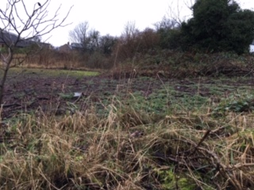
Car Park – 2018

Slide 26
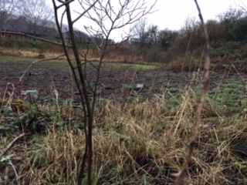
Car Park – 2018

Slide 27
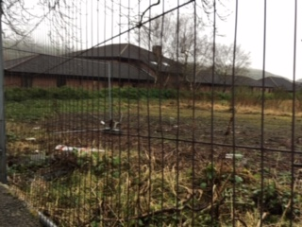
Car Park – 2018

Slide 28
Newchurch Village Community Association

